Slide 1
Authorship Attribution
By - Ashwin Srinath Sureshkumar
N16317183

Slide 2
Outline
Overview
  What is Authorship Attribution?
  Where to use it?
  Brief History
Machine Learning
  Project Design
  Dataset
  Data Preprocessing
  Metrics Used
  Algorithms and Techniques
  Text to numeric values
  CNN Architecture
Results
Reference

Slide 3
What is Authorship Attribution?
It is the task of identifying the author of a given text from a (given)
set of suspects

Slide 4
Where to use it?
To analyze anonymous or disputed documents/books.
Plagiarism detection - Establish whether claimed authorship is valid.
Forensic and Criminal investigations – Used in the verification of the authorship of e-mails, messages or even identifying the source of a piece of intelligence.
Classifying the manuscripts to appropriate historical timelines or eras.

Slide 5
A Brief History
1887 - Mendenhall first created the idea of counting features such as word length.
1938 and 1965 - Yule and Morton used the sentence lengths in order to judge authorship.
1996 - Forsyth and Holmes concluded that a text had to be a minimum of 250 words in length for the stylometric characteristics to be apparent.
2013 – Green, Sheppard and Schwartz had demonstrated the successful application of author attribution techniques to Twitter messages which “average less than 25 words” in length

Slide 6
Machine Learning
Project Design:
1) Collect, explore and preprocess the author attribution data
2) Split the dataset into training and test subsets using an 80%/20% split.
3) Create the n-gram character sequences and bag-of-words feature sets.
4)Implemented a CNN model to the n-gram character sequences.
5) Implemented the SVM model to the bag-of-words feature set.
6) Using the test dataset, evaluate and compare the fitted models

Slide 7
Dataset
The dataset comprises of works of eight classic authors
Louisa May Alcott
Jane Austen
Charlotte Bronte
Wilkie Collins
Arthur Conan Doyle
L.M.Montgomery
Bram Stoker and
Mark Twain
This dataset was created using novel texts sourced from Project Gutenburg website.

Slide 8
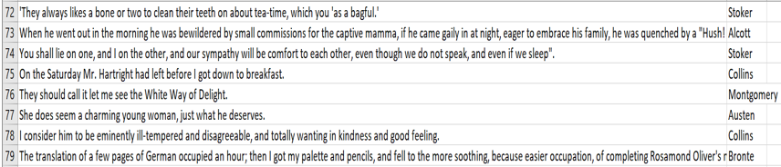
Data Preprocessing
Exclude sentences of less than 5 characters in length, as these are unlikely to be proper sentences and are likely too short to contain any useful information.
Remove the Chapter/section headings, invalid characters, large blocks of white space.
Convert all excerpts to lowercase.
Made minor adjustments to the text prior to tokenization eg ?” replaced to “? And .” replaced to “.
I have created sentence list for each of the author and then I have chosen a common number of sentences from each list, this I have then shuffled to form the final dataset.

Slide 9
Metrics Used
Performance of the models is evaluated based on the following metrics:
• Accuracy: Proportion of all test cases correctly classified by the model.
• Weighted average precision: The weighted average of the (test) precision values for all classes.
• Weighted average F1 score: The weighted average of the (test) F1 score values for all classes. F1 score is a metric that combines precision and recall.
•Confusion matrix: It provides a visual comparison of the actual versus predicted labels of examples at a class level.

Slide 10
Algorithms and Techniques
Convolutional neural networks (CNNs)
CNN with character n-grams as inputs is used.
Rectified linear unit (ReLU) activation function
CNN was implemented using Keras
Support vector machines(SVMs)
SVM with a bag-of-words feature is used.
Linear kernel
SVM was implemented using sklearn’s
SVC function.

Slide 11
Text to numeric values…
1) Word/Character Embedding:
2) Tfidf Vectorization:
Term Frequency – Inverse Document” Frequency.
Term Frequency: How often a given word appears within a document.
Inverse Document Frequency: This downscales words that appear a lot across documents.
Involves efficiently mapping one-hot encoded words to feature vectors. Here the words that are used in similar ways have similar feature representations.

Slide 12
CNN Architecture:
A 3-channel network, with each channel comprising of the following:
An embedding layer of dimension 26, in the 1-gram case; 300, in the 2-gram case; and 600, in the 3-gram case.
Kernels of size 3, 4 and 5 for each of the three
channels respectively, and a ReLU activation function.
The three channels were merged at the dense softmax output layer, with eight output units, one for each author.
In training this model, an Adam optimizer with learning rate of 0.0001 and a batch size of 32 was used, and the model was trained for 5 epochs.

Slide 13
Results:
The best results with regards to the validation accuracy was achieved by the 3-gram CNN (followed by the 2-gram CNN, then the 1-gram CNN).
The 4 channel 3-gram model gave lower validation accuracy than the 3-channel model.
In the case of the SVM, I used a linear kernel and considered C values in the set {1,10, 100}. The optimal value of C was determined using sklearn’s GridSearchCV function with 3-fold cross-validation and accuracy used as the scoring metric and it turned out to be C = 1.

Slide 14
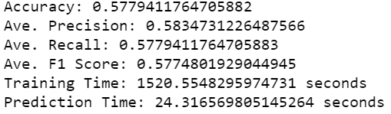
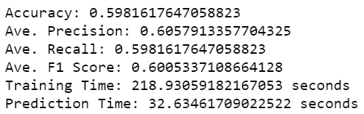
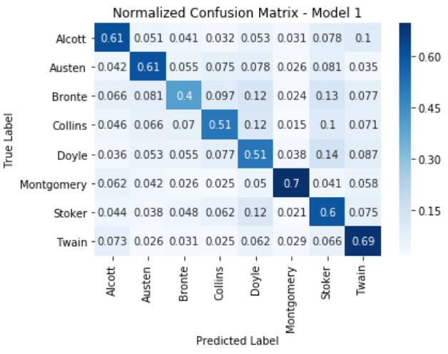
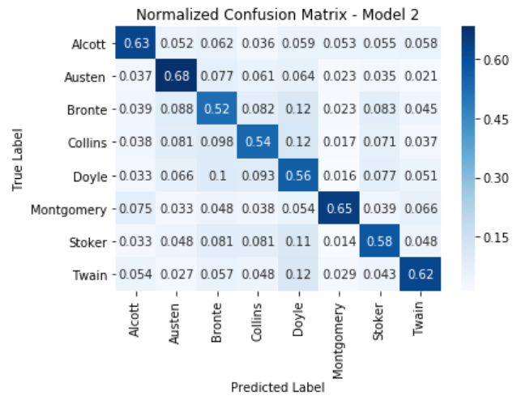
Results contd…
Model 1- CNN
Model 2- SVM

Slide 15
Reference
1. Brownlee, J. (2017). What are Word Embeddings for Text? https://
machinelearningmastery.com/what-are-word-embeddings/.
Diederich, J., J. Kindermann, E. Leopold, and G. Paass (2003). Authorship attribution with support vector machines. Applied Intelligence 19, 109–123.
2. Forsyth, R. and D. Holmes (1996). Feature finding for text classification. Literary and Linguistic Computing 11(4), 163–174.
3. Green, R. and J. Sheppard (2013). Comparing frequency- and style-based features for Twitter author identification. Proceedings of the Twenty-Sixth International Florida Artificial Intelligence Research Society Conference, 64–69
4. Shrestha, P., S. Sierra, F. Gonz´alez, P. Rosso, M. Montes-y G´omez, and T. Solorio (2017).Convolutional neural networks for authorship attribution of short texts. Proceedings of the 15th Conference of the European Chapter of the Association for Computational Linguistics: Volume 2, Short Papers. Valencia, Spain, 669–674.

Slide 16
Thank You

